Slide 1

Data Structures and Algorithms
(CS221)
Stacks

Slide 2
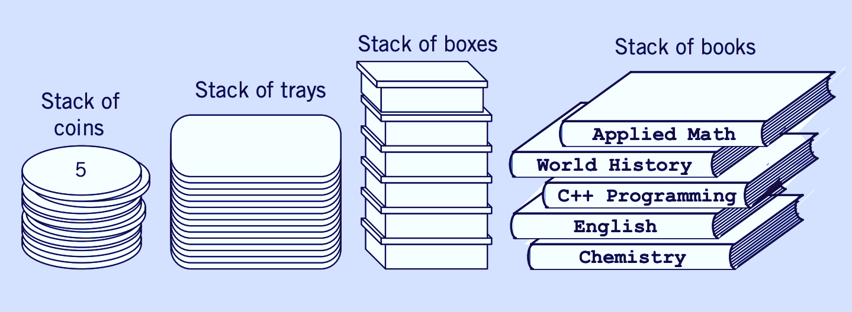
Stacks

Slide 3
Stacks
Known as LIFO Lists
Last in, First Out
Basic operations
Push
Pop
Top
Implementation
Array implementation
Linked list implementation

Slide 4
Stack operations
Push
Add an element/data at the top of the stack
Pop
Remove and element/data from the top of the stack
Top
Read the contents of the top element in the stack

Slide 5
Stack operations
top
= 1
top
= 0
top
= -1
Empty
Stack
Push
Push
top
= 0
top
= -1
Pop
Pop

Slide 6
Stack ADT: static Array Implementation
Maximum Size of the stack is fixed
When the stack is empty
top = -1
Push operation
top = top+1
Stack[top] = newData
Pop operation
topData=Stack[top];
top =top-1;
Complexity: O(1)

Slide 7
Stack ADT: static Array Implementation
Stack Declaration
const int N = 5;
int stack[N];
int top;
Read Operation
int ReadTop(){
if(top == -1){
cout<<"\nError: Stack is Empty\n";
return -1;
}
else{
cout<<"\nThe top elmenet is\n"<<stack[top];
return stack[top];
}
}

Slide 8
Stack ADT: static Array Implementation
Push Operation
void Push(int newData){
if(top == N-1)
cout<<"\nError: Stack is Full\n";
else{
top=top+1;
stack[top] = newData;
cout<<"\npushing "<< newData <<" at the top\n";
}
}

Slide 9
Stack ADT: static Array Implementation
Pop Operation
int Pop(){
int topData;
if(top == -1){
cout<<"\nError: Stack is Empty\n";
return -1;
}
else {
topData = stack[top];
cout<<"\nremoving "<< stack[top] <<" from the top\n";
top = top-1;
return topData;
}
}

Slide 10
Stack ADT: static Array Implementation
void main(){
ReadTop();
Pop();
Push(1);
Push(2);
Push(3);
Push(4);
Push(5);
Push(6);
Pop();
ReadTop();
Pop();
ReadTop();
getch();
}

Slide 11
Stack ADT: Linked List Implementation
Stack Declaration
//const int N=5;
struct stack{
int data;
stack*next;
};
stack *topPtr = NULL;
Read Operation
int ReadTop() {
if(topPtr == NULL){
cout<<"\nError: Stack is Empty\n";
return -1;
}
else{
cout<<"\nThe top elmenet is\n“ <<topPtr->data;
return topPtr->data;
}
}
topPtr
Null

Slide 12
Stack ADT: Linked List Implementation
Push Operation
void Push(int newData){
// if(top==N-1)
// cout<<"\nError: Stack is Full\n";
// else{
stack *ptr = new stack; or node *ptr = new node
ptr->next = topPtr;
topPtr=ptr;
topPtr->data = newData;
cout<<"\npushing "<< newData <<" at the top\n";
// }
}
ptr
ptr
topPtr
newData
newData
Null
data
next
data
next

Slide 13
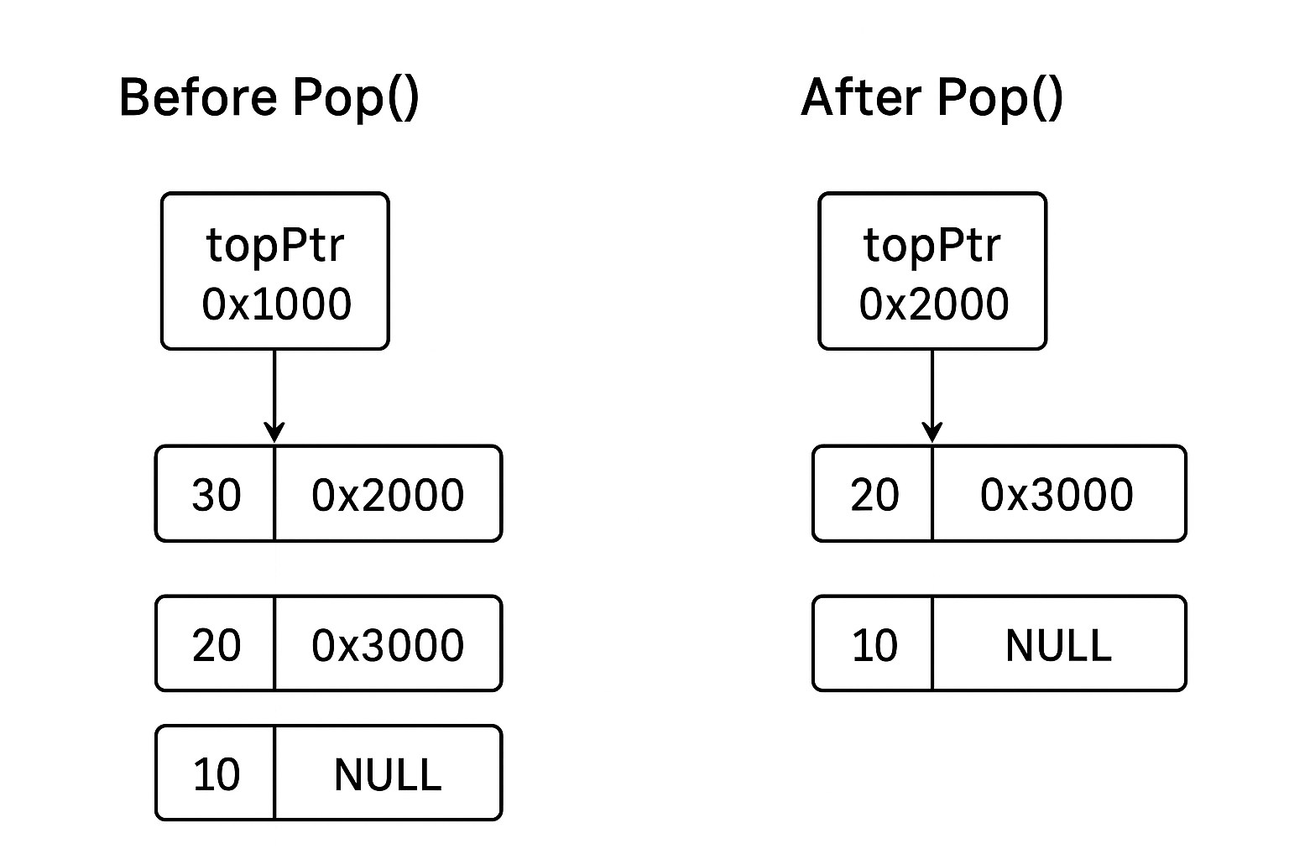
Stack ADT: Linked List Implementation
Pop Operation
int Pop(){
int topData;
if(topPtr == NULL){
cout<<"\nError: Stack is Empty\n";
return -1;
}
else {
topData = topPtr->data;
cout<<"\nremoving "<< topPtr->data <<" from the top\n";
topPtr = topPtr->next;
return topData;
}
}
topPtr
Null
topPtr
topData = topPtr->data
data
next
Null

Slide 14
Stacks Application: Balancing Symbols
A lack of a certain symbol (such as a missing brace or a comment starter) will cause the compiler to spill out a hundred lines of diagnostics without identifying the real error.
Solution?
Check whether everything is balanced?
Every right brace, bracket, parenthesis and etc must correspond to its left counter part

Slide 15
Stack used for Balancing Symbols
Make an empty STACK
Read characters until the end of file
If the character is an opening symbol
Push it onto the STACK
If the character is a closing symbol
If the STACK is empty
Report error
Else
Pop the STACK
If the symbol popped is not the corresponding symbol
Report error
If the STACK is not empty in the end
Report error

Slide 16
EXAMPLE: STACKS USED FOR BALANCING SYMBOLS
(a + b * c) / [(a – b) ^ c]
Read → ( → Push (
Read → a
Read → +
Read → b
Read → *
Read → c
Read → ) → Pop
Read → /
Read → [ → Push [
Read → ( → Push (
Read → a
Read → -
Read → b
Read → ) → Pop
Read → ^
Read → c
Read → ] → Pop
(
[
(
[
[

Slide 17
EXAMPLE: STACKS USED FOR BALANCING SYMBOLS
[(a - b / c) / [(a – b) * c
Read → [ → Push [
Read → ( → Push (
Read → a
Read → -
Read → b
Read → /
Read → c
Read → ) → Pop
Read → /
Read → [ → Push [
Read → ( → Push (
Read → a
Read → -
Read → b
Read → ) → Pop
Read → *
Read → c
[
(
[
[
[
[
(
[
[
[
Stack Not Empty
Error!
[

Slide 18
EXAMPLE: STACKS USED FOR BALANCING SYMBOLS
(a - b * c) ] / [[(a – b) ^ c]
Read → ( → Push (
Read → a
Read → -
Read → b
Read → *
Read → c
Read → ) → Pop
Read → ] → Pop
(
Stack Empty
No matching opening symbol
Error!

Slide 19
Postfix and Infix expression
Infix Expression
(5 + 3) * 8
Parentheses determine precedence.
Equivalent Postfix Expression
5 3 + 8 *
No parentheses needed, evaluated left to right using a stack.

Slide 20
Infix expression
In infix notation, the operator is written between the operands.
This is the normal way humans write mathematical expressions.
Requires operator precedence (e.g., * before +) and parentheses to indicate order.
Problem:
Check operator precedence (like * before)
Handle parentheses properly

Slide 21
Postfix expression
In postfix notation (also called Reverse Polish Notation or RPN), the operator comes after the operands.
No need for parentheses or precedence rules because the order of operations is implicitly clear by position.

Slide 22
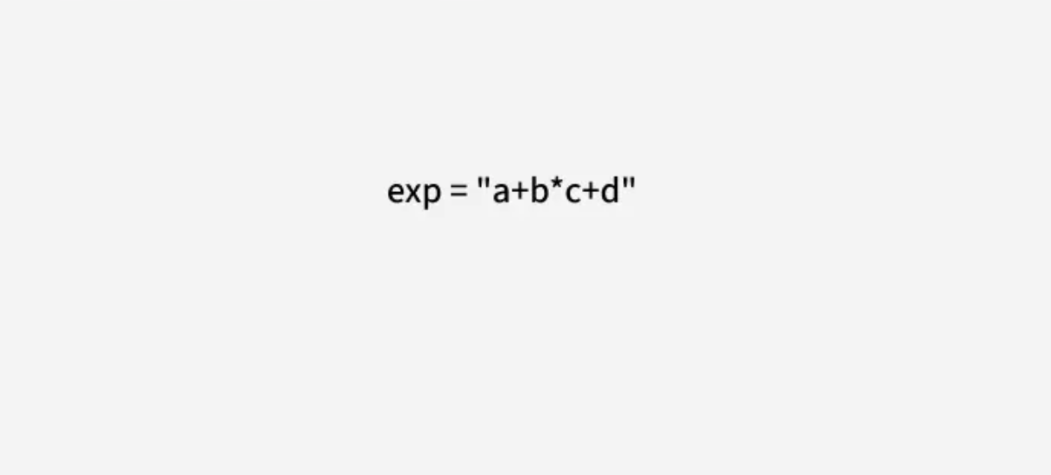

Slide 23
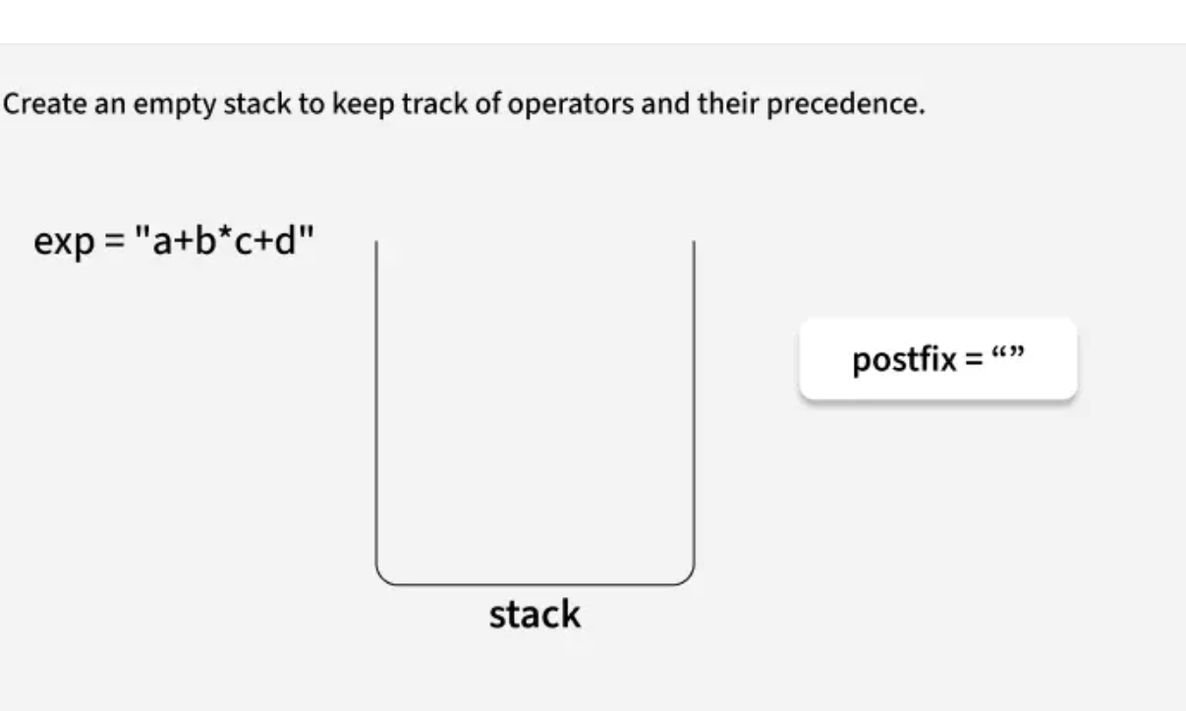

Slide 24
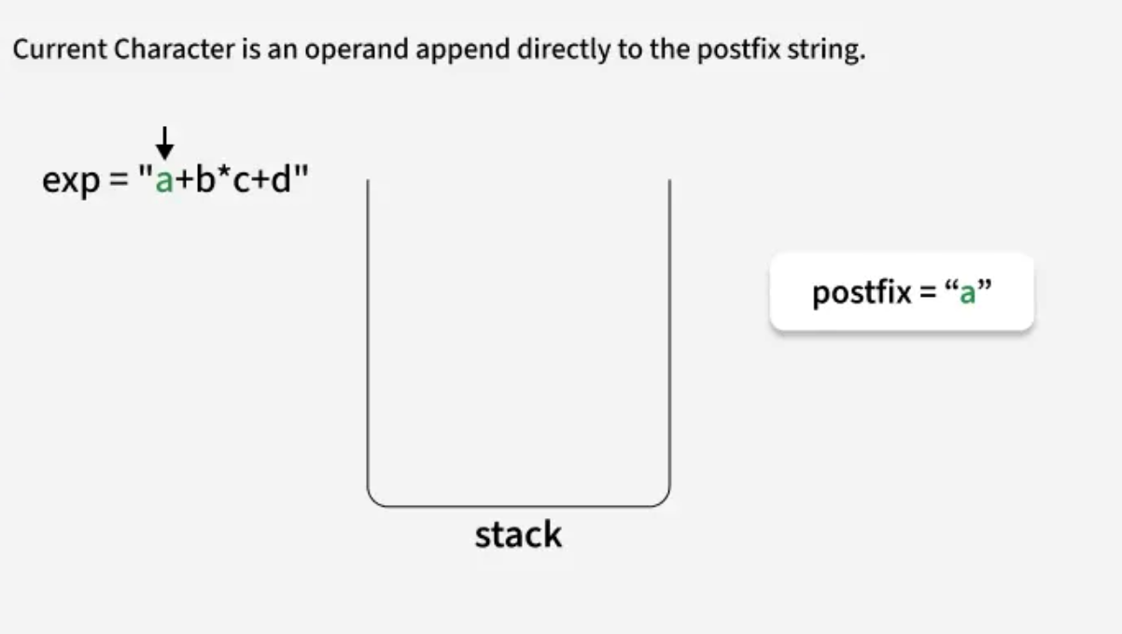

Slide 25
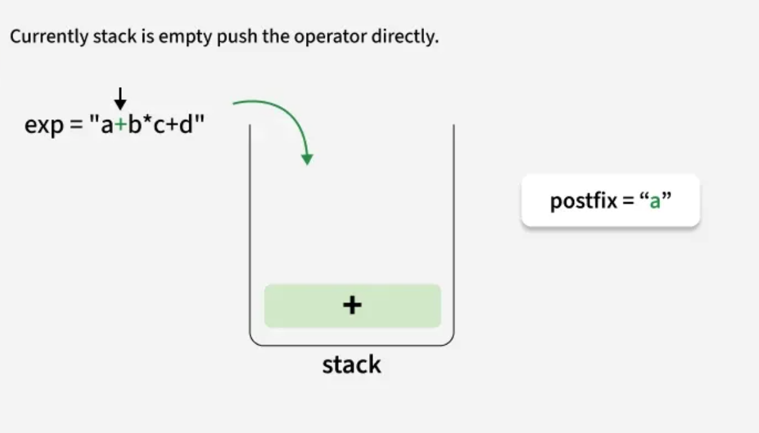

Slide 26
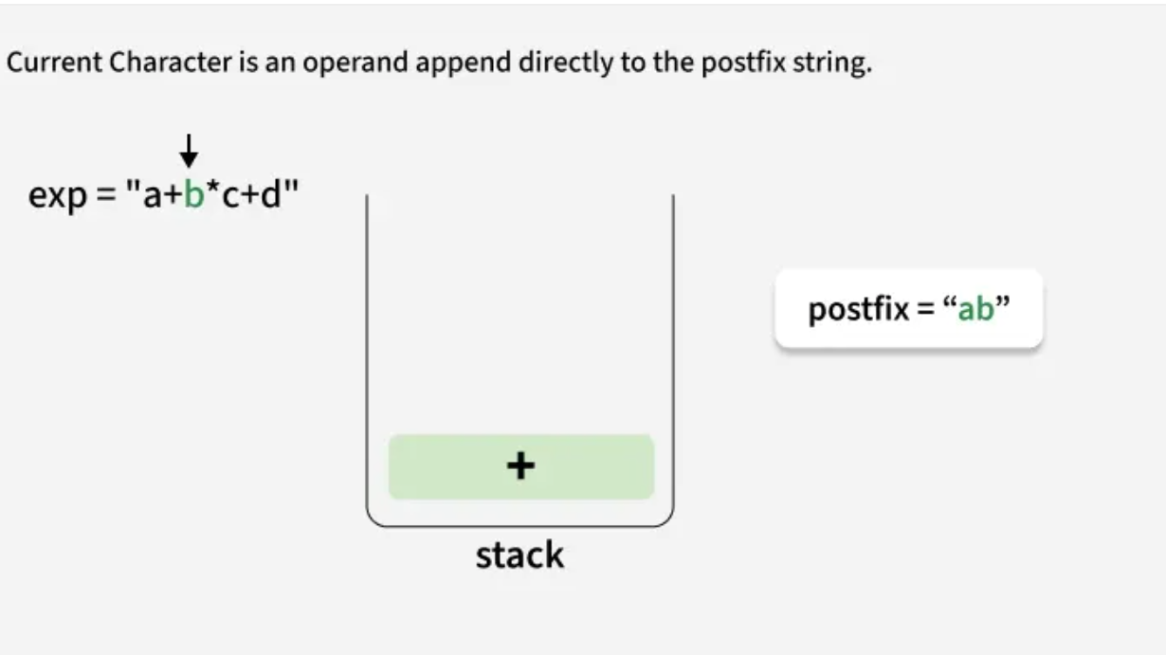

Slide 27
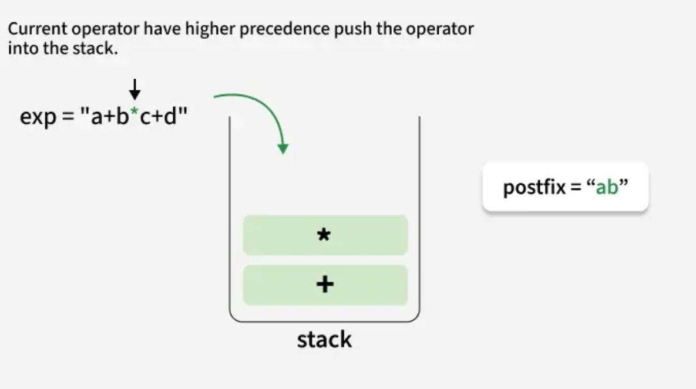

Slide 28
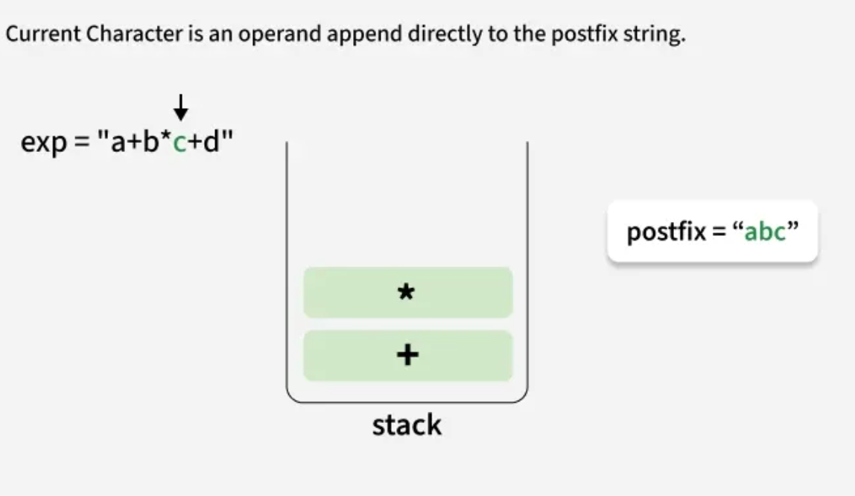

Slide 29
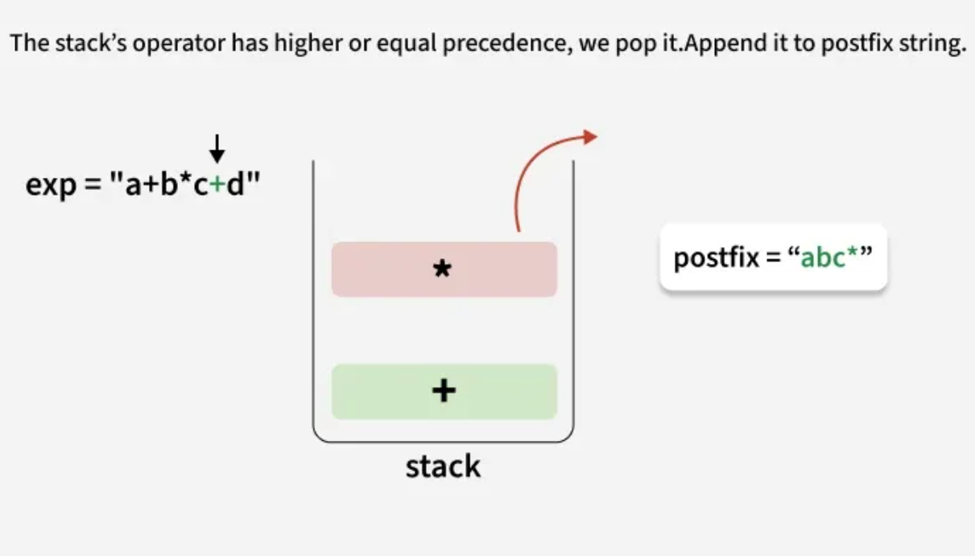

Slide 30
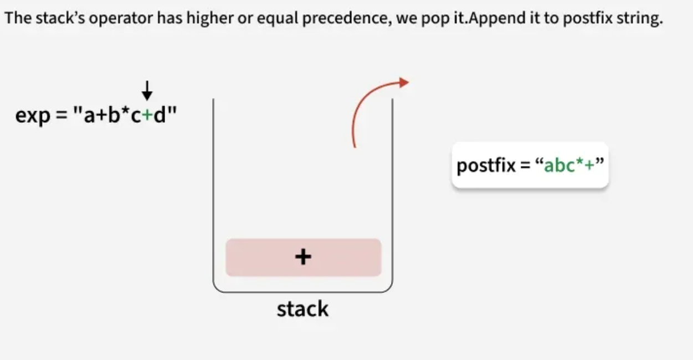

Slide 31
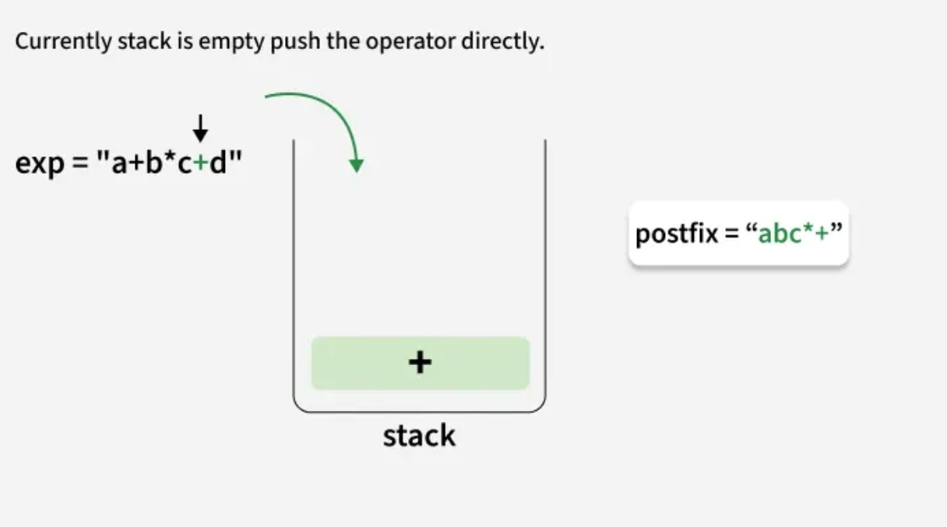

Slide 32
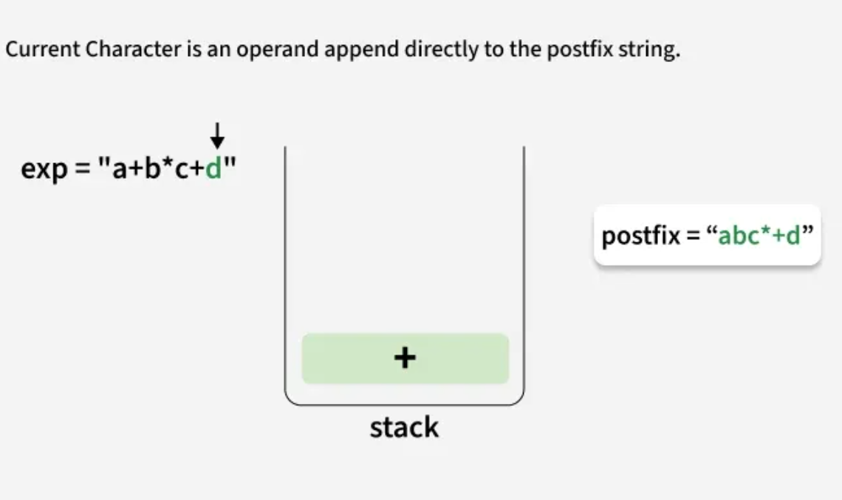

Slide 33
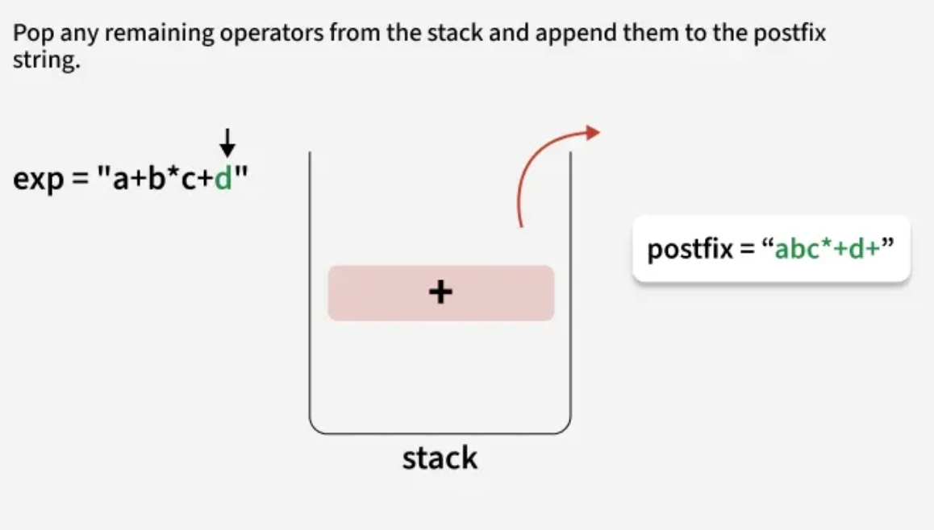

Slide 34
Infix Expression | Equivalent Postfix Expression
a + b | ab +
a + b * c | abc * +
a * b + c | ab * c +
(a + b) * c | ab + c *
(a – b) * (c + d) | ab – cd + *
(a + b) * (c – d / e) + f | ab + cde / – * f +

Slide 35
STACK USED TO EVALUATE A POSTFIX EXPRESSION
Make an empty STACK
Add a right parenthesis ‘)’ at the end of expression P
Scan P from left to right and repeat the following steps for each element of P until the sentinel ‘)’ is encountered
If an operand is encountered
Push the operand into the STACK
Else if an operator ® is encountered
Remove the top two elements A and B (A = top, and B = next to top )of the STACK
Evaluate B ® A
Push the result of (b) into STACK
End if
End repeat
Set the Result equal to the top element of the STACK
Exit

Slide 36
EXAMPLE: STACK USED TO EVALUATE A POSTFIX EXPRESSION
6523+8*+3+* → 6523+8*+3+*)
3
2
2
5
5
5
6
6
6
6
Read :→ 6
→ Push 6
Read :→ 5
→ Push 5
Read :→ 2
→ Push 2
Read :→ 3
→ Push 3
8
5
5
40
5
5
5
45
6
6
6
6
Read :→ +
→ Pop 3, Pop 2
2 + 3 = 5
Push 5
Read :→ 8
→ Push 8
Read :→ *
→ Pop 8, Pop 5
5 * 8 = 40
Push 40
Read :→ +
→ Pop 40, Pop 5
5 + 40 = 45
Push 45
3
45
48
6
6
288
288
Read :→ 3
→ Push 3
Read :→ +
→ Pop 3, Pop 45
45 + 3 = 48
Push 48
Read :→ *
→ Pop 48, Pop 6
6 * 48 = 288
Push 288
Read :→ )
Result = STACK[top]
= 288

Slide 37
STACK USED TO TRANSFORM AN INFIX EXPRESSION INTO POSTFIX EXPRESSION
Suppose the infix expression Q has to be converted into the postfix expression P
Make an empty STACK
Push the left parenthesis ‘(’ into the STACK and add the right parenthesis ‘)’ at the end of expression Q
Scan Q from left to right and repeat the following steps for each element of Q until the STACK is empty
If an operand is encountered
Add it to P
Else if a left parenthesis is encountered
Push it into the STACK
Else if an operator ® is encountered
(a) Repeatedly pop from STACK and add to P each operator (at the top of STACK) which has the same precedence as or higher than that of ®
(b) Push ® into the STACK
Else if a right parenthesis is encountered
(a) Repeatedly pop from STACK and add to P each operator (at the top of
STACK ) until a left parenthesis is encountered
(b) Remove the left parenthesis from STACK (but do not add it P)
End if
End repeat
Shunting-yard algorithm
A , B, 1, 2, 3 ,…
P
{ , [ , (
(
+
* , / , + , - , ^
*
+
} , ] , )
-
+
(

Slide 38
STACK EXAMPLE: INFIX EXPRESSION INTO POSTFIX EXPRESSION
6*[5+ (2+3)*8+3] → ( 6 * [ 5 + ( 2 + 3 ) * 8 + 3 ] )
[
[
*
*
*
(
(
(
(
(
Read :→ (
→ Push (
OUTPUT:
Read :→ 6
Add 6 to P
OUTPUT:
Read :→ *
→ Push *
OUTPUT:
Read :→ [
→ Push [
OUTPUT:
Read :→ 5
Add 5 to P
OUTPUT:
6
6
6
65
+
(
(
(
+
+
+
+
[
[
[
[
*
*
*
*
(
(
(
(
Read :→ +
→ Push +
OUTPUT:
Read :→ (
→ Push (
OUTPUT:
Read :→ 2
Add 2 to P
OUTPUT:
Read :→ +
→ Push +
OUTPUT:
65
65
652
652

Slide 39
STACK INFIX TO POSTFIX EXPRESSION
(6 * [ 5 + ( 2 + 3 ) * 8 + 3 ] ) → 6523+8*+3+*
+
+
(
(
*
*
+
+
+
+
+
[
[
[
[
[
*
*
*
*
*
(
(
(
(
(
Read :→ +
→ Push +
OUTPUT:
Read :→ 3
Add 3 to P
OUTPUT:
Read :→ )
→ Pop +, Add + to P
Pop (
OUTPUT:
Read :→ *
→ Push *
OUTPUT:
Read :→ 8
Add 8 to P
OUTPUT:
652
6523
6523+
6523+
6523+8
+
+
[
[
*
*
*
(
(
(
Read :→ +
→ Pop *, Add * to P
→ Pop +, Add + to P
Push +
OUTPUT:
Read :→ 3
Add 3 to P
OUTPUT:
Read :→ ]
→ Pop +, Add + to P
Pop [
OUTPUT:
Read :→ )
→ Pop *, Add * to P
Pop (
OUTPUT:
6523+8*+
6523+8*+3
6523+8*+3+
6523+8*+3+*

Slide 40
Questions?
zahmaad.github.io

